Slide 1

Cougar Downstream passage 60% DDR Progress update
Chris Budai, PM
Jeremy Britton, TL
Scott Fielding, PM-E
Logan Negherbon, EC-HD
Ryan Souders, EC-DM
7 November 2017

Slide 2
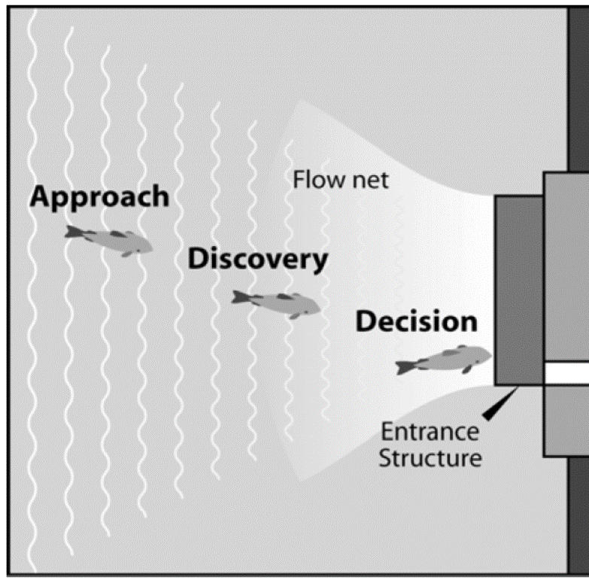
Meeting Purpose
Discuss the 60% Design Documentation Report (DDR) with WFFDWG
Risk Factors Driving Design
How Design Address Risk Factors
Focus Areas Moving Forward
Far field
Near field

Slide 3
Schedule
60% DDR
WFFDWG review – November 1 – December 11, 2017
Overall Project Schedule
DDR Complete – April 2018
Plans & Specifications Complete – September 2019
Award – Construction – Third Quarter 2020
Construction Complete – 2022

Slide 4
Risk Factors Driving Design
Location
Cul-de-sac
Entrance near Water Temperature Control Tower (WTCT)
Pool Fluctuation
Fish collection from 1532 feet to 1690 feet
Flow
Design flow
Competing flow
Entrance
Shape and configuration
Fish collection 20 to 30 feet below water surface

Slide 5
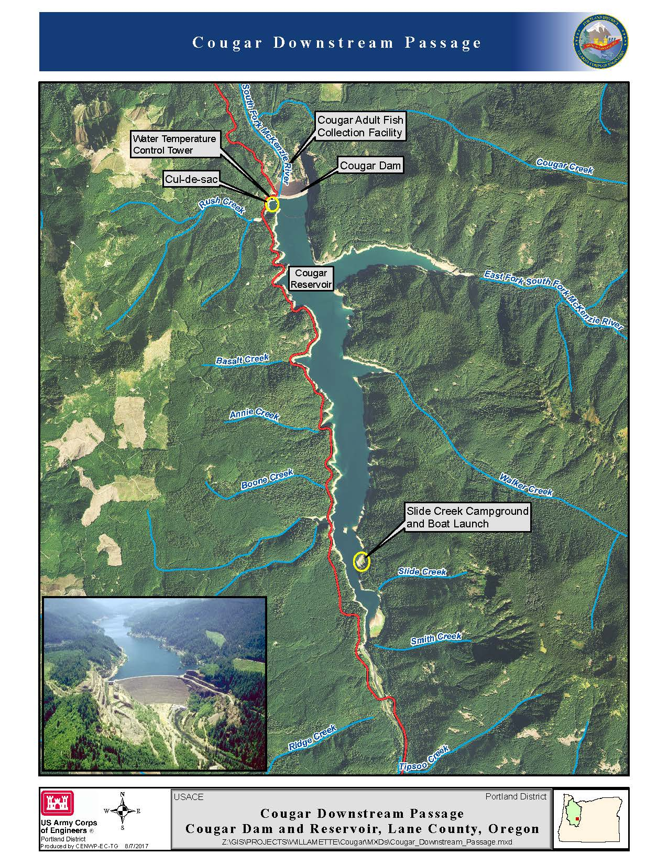
Location within Reservoir

Slide 6
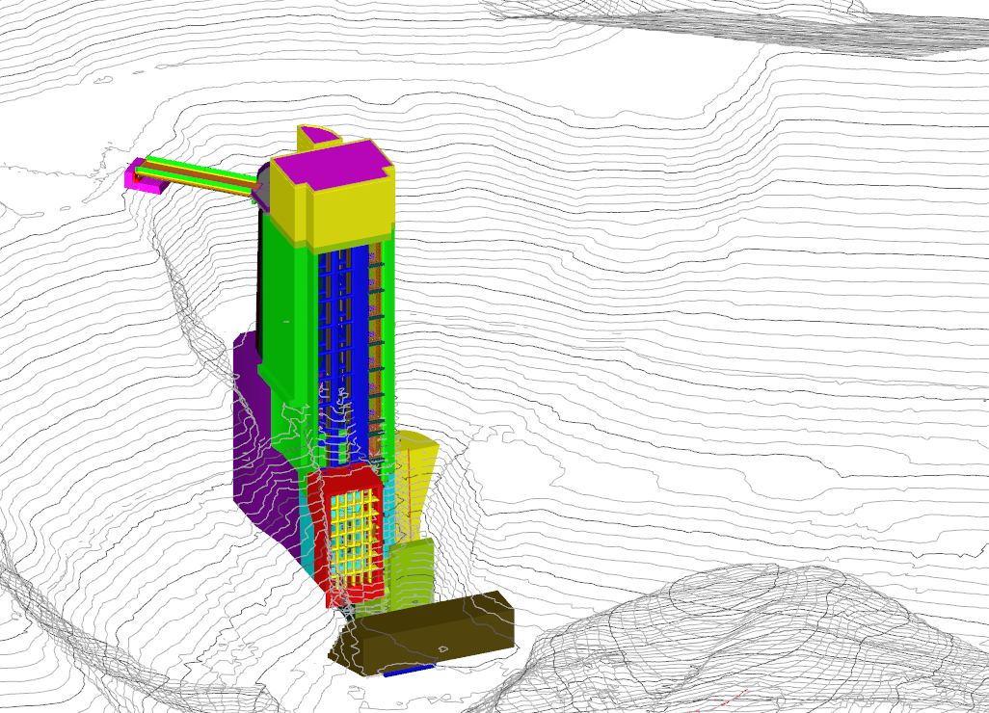
Location in the Cul-de-sac
PARKING
LOT
PARKING
LOT
WTCT
EL.1699
COUGAR
RESERVOIR
EL.1541
CRANE PAD
EL. 1470
RUSH
CREEK

Slide 7
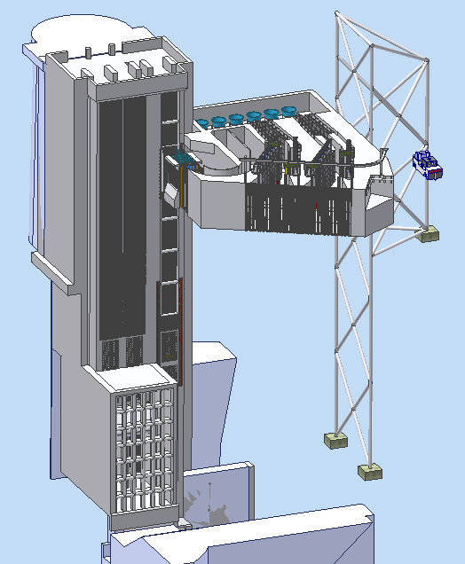
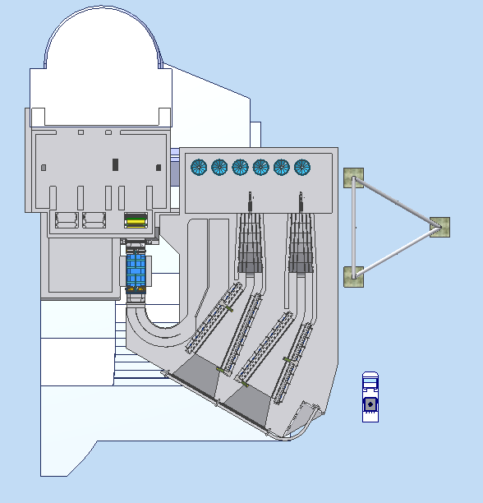
Location – Near Water Temperature Control tower
WTCT
FSS
MOORING
TOWER
MOORING
TOWER
WTCT
AMPHIBIOUS
VEHICLE
FSS
AMPHIBIOUS
VEHICLE

Slide 8
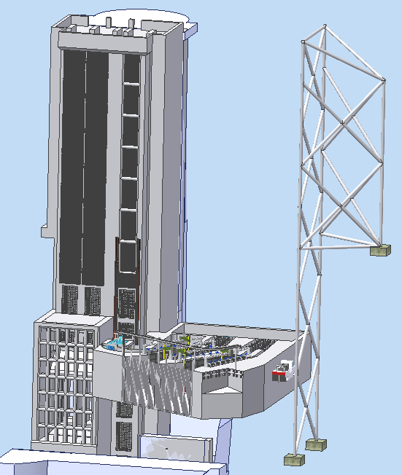
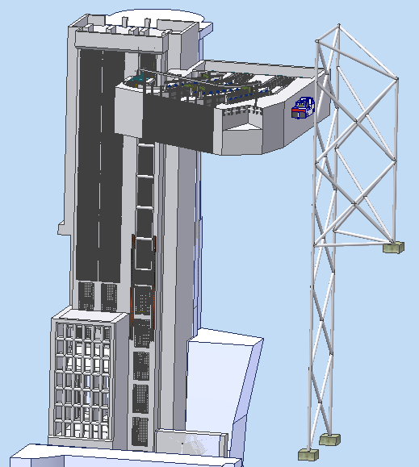
Pool Fluctuations

Slide 9
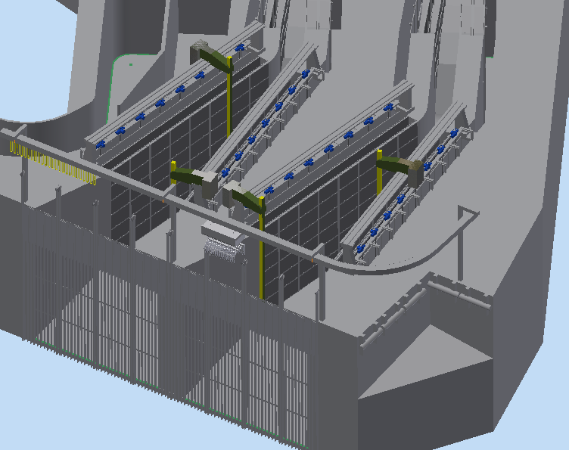
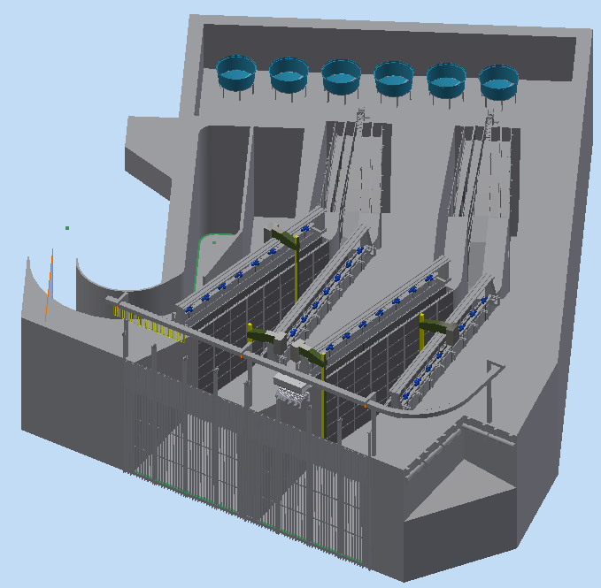
Design Flow: 300 – 1,000 cfs
400 600

Slide 10
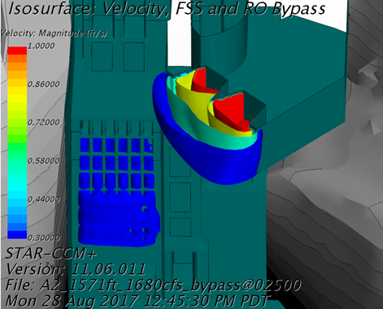
flow
FSS design flow is 300 cfs to 1,000 cfs
This covers the majority of outflows
Two months when flows often above 1,000 cfs
AND fish are passing:
Fry in May (pool above 1571)
Yearlings in January (pool below 1571)
When pool is above 1571, excess flow passes over WTCT weirs – fish don’t like to pass trash racks in front of weirs
When pool is below 1571, excess flow passes RO bypass gate

Slide 11
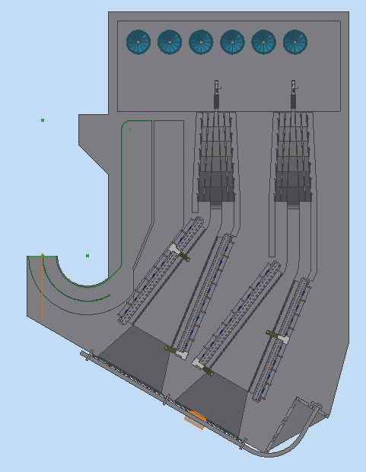
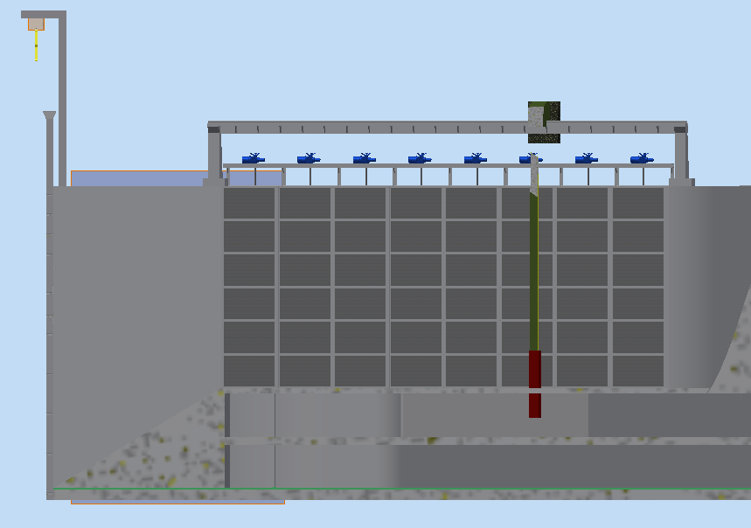
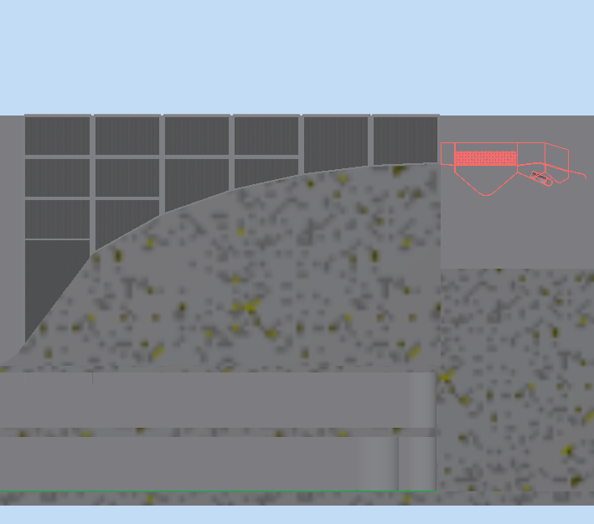
Entrance shape & Configuration
16 FT
25 FT
ENTRANCE
RAMP
PRIMARY SCREENS
310-420 CFS
SECONDARY
SCREENS
145-195 CFS
≈ 2/3 of the flow
≈ 1/3 of the flow

Slide 12
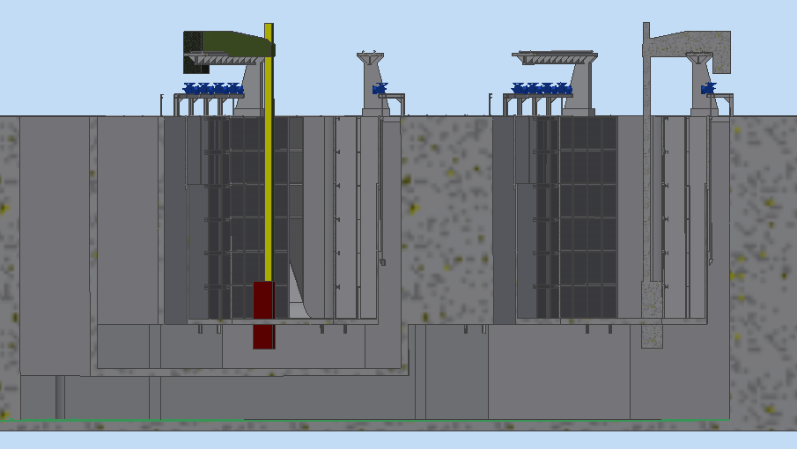
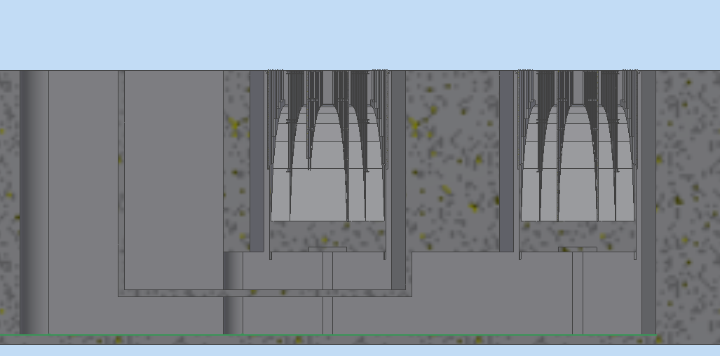
Water Movement Through System
SECONDARY DEWATERING
PRIMARY DEWATERING
SECONDARY DEWATERING
PRIMARY DEWATERING

Slide 13
Fish Movement Through System
CAPTURE VELOCITY
~7.25 FT/S TAKES PLACE
WITHIN THE SECONDARY SCREENS.
AV W/ TRANSPORT TANK

Slide 14
Focus areas moving forward
FSS Entrance:
Hydraulic modeling (CFD and physical)
Potential adaptive management measures:
Guidance structures (e.g. nets)
Reservoir operations
Modifiable FSS entrance
Other:
Debris management
Rock excavation
Defining O&M needs
WTCT weir leakage

Slide 15
Extra slides

Slide 16
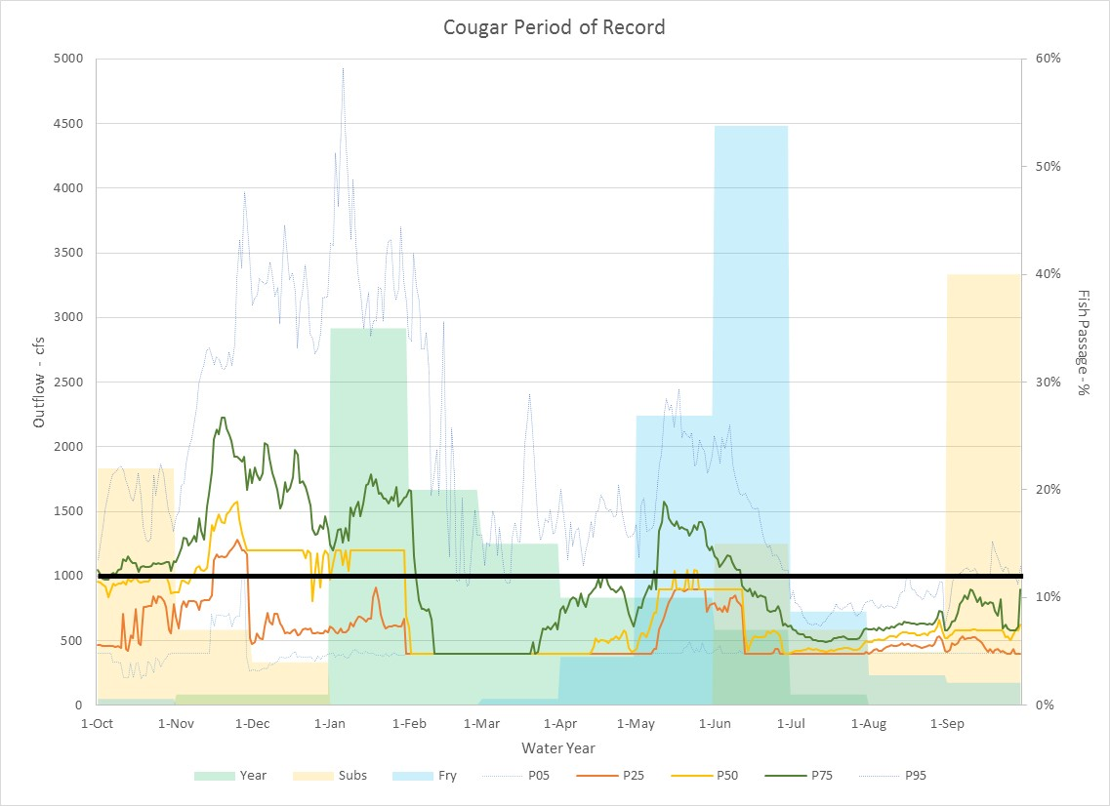
Daily Exceedance Outflow (cfs)
Percent of Fish Available for Passage with FSS

